Slide 1


PITCH DECK
TEAM CORE CREATORS

Slide 2


OPPORTUNITY
01
HARDWARE TERMINALS
Facing high POS Terminal maintenance as well as server & network issues.
02
FOR INDIVIDUALS
Bank charges monthly service charge to use their application and services depending on the bank.
03
FOR BUSINESSES
As per the source credit card processing fees range from 1.5% to 3.5% per transaction, which cuts into profit and requires costly POS maintenance.

Slide 3

SOLUTION FOR INDIVIDUALS
01
WAVING OFF TRANSFER FEES
User can transfer funds from their bank to our secure wallet without any extra charges. No recurring fees for each transactions: Simply scan our QRPay code to pay seamlessly with the wallet balance.
02
CRYPTO INTEGRATION
Users can buy and sell crypto directly through our app’s wallet, giving them potential for additional returns on stored funds.

Slide 4

SOLUTION FOR BUSINESSES
01
REDUCED TRANSACTION FEES
QRPay will brings down the processing fees to 0.5% to 1% where the bank charges from 1.5% to 3.5%.
02
NO POS TERMINAL NEEDED
Our QR-based system simplifies payment setup, making it Cost-Effective and easier to maintain.
03
CUSTOMER FRIENDLY
This offers businesses a way to provide a better checkout experience and increase sales.

Slide 5






HOW WE STAND OUT
NO REPEATED TRANSACTION FEES
ONE-STOP SOLUTION
LOW-COST ALTERNATIVE

Slide 6

REVENUE OPPORTUNITIES
Wallet Investment Revenue
By strategically investing a portion of users’ wallet funds, the app can earn interest, creating a steady revenue stream without extra fees for users.
Customer Retention & Engagement Features
Our app will offer multiple features to keep users engaged, such as paying utilities, buying insurance, paying internet bills, booking appointments etc., creating a One-Stop Solution that encourages regular app usage.
Advertising and Partnership
As QR Pay grows, our company can generate ad revenue by partnering with businesses to feature their QR codes and exclusive offers.

Slide 7
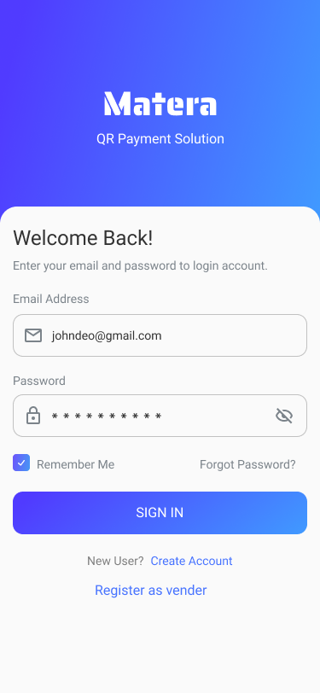
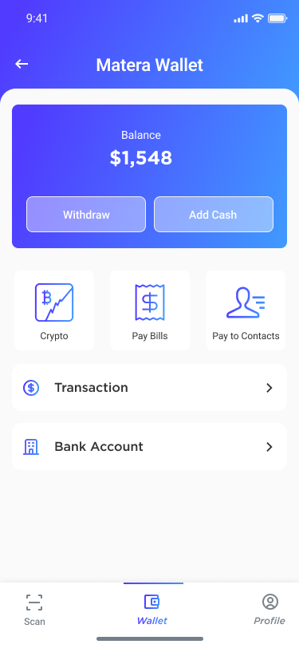
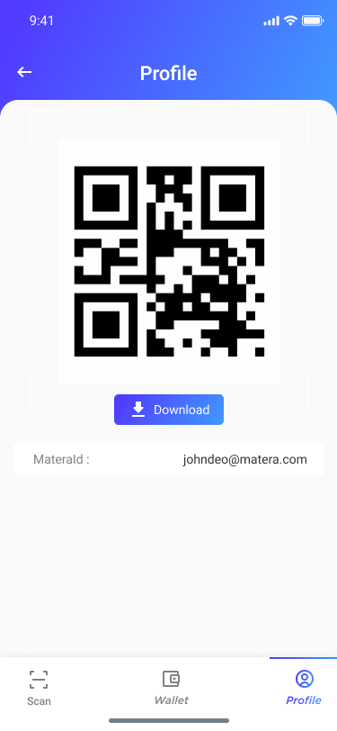
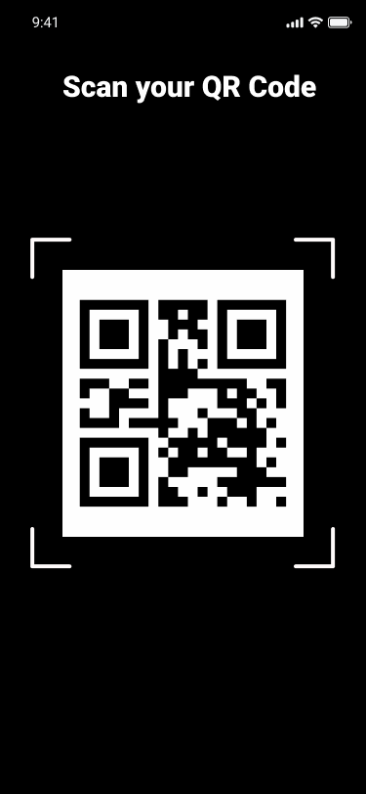
PROTOTYPE
Sign In page
Home Screen
Vendor QR
Scan QR

Slide 8
THANK YOU FOR YOUR TIME AND CONSIDERATION

